Slide 1


Moodle Plugin Für Verifiable Credentials
Badges als Sprachnachweise
Motivation | Übersicht | Architektur| Ausstellungsprozess | Verifizierungsprozess | Demo | Outlook | Refferenzen
Patrick Herbke, Jonas Krause | Fachgebiet Service-centric Networking | TU Berlin & Telekom Innovation Laboratories
Notes:
Remarks
- Mandatory: Presentation title, presentation structure, name & affiliation
- Title photo can be replaced by another that fits to the presentation (if no appropriate photo is available, go with this one)

Slide 2



1.1 Motivation
Moodle
Open-Source-Plattform für E-Learning
Über 46 Mio. Kurse
Über 250.000 Bildungseinrichtungen
TU Berlin Zems
Zentraleinrichtung Moderne Sprachen
Chinesisch, Englisch, Französisch, Italienisch, Portugiesisch, Russisch, Spanisch und Deutsch als Fremdsprache
Stellt Sprachzertifikate aus (PDF)
Open Badges
Standard vom World Wide Web Consortium (W3C)
Verifiable Credentials
Digital signierbare Bildungsnachweise die online erworben wurden
MOODLE PLUGIN FÜR VC | JONAS KRAUSE | 25. SEPTEMBER 2023
Notes:
Slide with one picture
Remarks:
picture is to be placed preferably on the left hand side
picture should be framed and have a small shadow (use features of the presentation tool, but make sure to use the same properties on all slides)
text goes on the right hand side
normal text in bullet points: Helvetica 30 pts (or larger, but use the same font size on all slides)
titles for bullet points: Helvetica 40 pts (or larger, approx 10pts larger than normal text, but use the same font size on all slides) - titles for bullet points are optional
Slide title: Helvetica, 45 pt, bold, uppercase (mandatory)
Slide sub-title: Helvetica, 45 pt, uppercase (optional)
Reference lines are like red lines - they must not be crossed (only in some exceptional cases like for pictures with oversize)
Slide is to be built from bottom to top - start with aligning content and pictures at the bottom reference line

Slide 3
1.2 Übersicht
Herausforderung
Ausstellung von vertrauenswürdigen, digitalen Sprachzertifikaten
Ziel
Digitale Sprachnachweise für Studierende als Verifiable Credentials
Lösung
Idee: Integration von Hyperledger Indy in E-Learning Plattform Moodle unter Anwendung von Open Badges Standard
Language Certificate
English A1
Alice Smith
Issuance Date: 2023-09-22
Issuer Name: Zems TU Berlin
Users are awarded this badge when they complete the following requirement:
…
Darstellung eines Sprachzertifikats
MOODLE PLUGIN FÜR VC | JONAS KRAUSE | 25. SEPTEMBER 2023
Notes:
Slide with one picture
Remarks:
picture is to be placed preferably on the left hand side
picture should be framed and have a small shadow (use features of the presentation tool, but make sure to use the same properties on all slides)
text goes on the right hand side
normal text in bullet points: Helvetica 30 pts (or larger, but use the same font size on all slides)
titles for bullet points: Helvetica 40 pts (or larger, approx 10pts larger than normal text, but use the same font size on all slides) - titles for bullet points are optional
Slide title: Helvetica, 45 pt, bold, uppercase (mandatory)
Slide sub-title: Helvetica, 45 pt, uppercase (optional)
Reference lines are like red lines - they must not be crossed (only in some exceptional cases like for pictures with oversize)
Slide is to be built from bottom to top - start with aligning content and pictures at the bottom reference line

Slide 4



1.3 Architektur
Open Badge
…
…
…
Proof
…
…
…
Holder Agent
Aries Cloud Agent Python
Alice‘s Wallet
Issues via
Moodle Plugin
Proof
Presentation
Issuer Agent
Verifier Agent
Aries Cloud Agent Python
Aries Cloud Agent Python
Creates Schema and Credential Definition
Verification of Signature and Non-Revocation
Verifiable Data Registry
MOODLE PLUGIN FÜR VC | JONAS KRAUSE | 25. SEPTEMBER 2023
Notes:
Slide with one picture
Remarks:
picture is to be placed preferably on the left hand side
picture should be framed and have a small shadow (use features of the presentation tool, but make sure to use the same properties on all slides)
text goes on the right hand side
normal text in bullet points: Helvetica 30 pts (or larger, but use the same font size on all slides)
titles for bullet points: Helvetica 40 pts (or larger, approx 10pts larger than normal text, but use the same font size on all slides) - titles for bullet points are optional
Slide title: Helvetica, 45 pt, bold, uppercase (mandatory)
Slide sub-title: Helvetica, 45 pt, uppercase (optional)
Reference lines are like red lines - they must not be crossed (only in some exceptional cases like for pictures with oversize)
Slide is to be built from bottom to top - start with aligning content and pictures at the bottom reference line

Slide 5
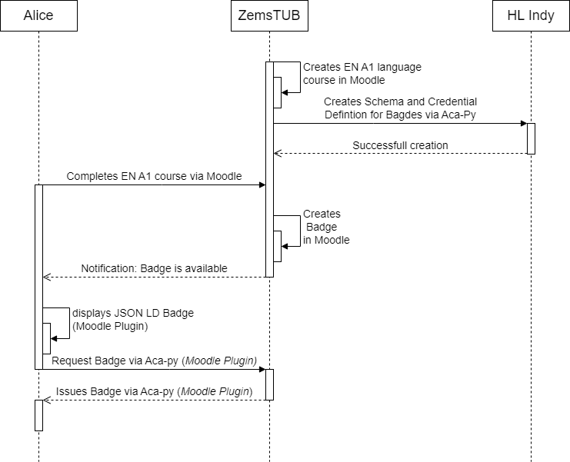
2.1 Ausstellungsprozess
Contribution:
MOODLE PLUGIN FÜR VC | JONAS KRAUSE | 25. SEPTEMBER 2023
Notes:
Slide with text in two columns
Remarks:
Reference lines are like red lines - they must not be crossed (only in some exceptional cases like for pictures with oversize)
Slide is to be built from bottom to top - start with aligning content and pictures at the bottom reference line
Slide title: Helvetica, 45 pt, bold, uppercase (mandatory)
Slide sub-title: Helvetica, 45 pt, uppercase (optional)
normal text in bullet points: Helvetica 30 pts (or larger, but use the same font size on all slides)
titles for bullet points: Helvetica 40 pts (or larger, approx 10pts larger than normal text, but use the same font size on all slides) - titles for bullet points are optional

Slide 6
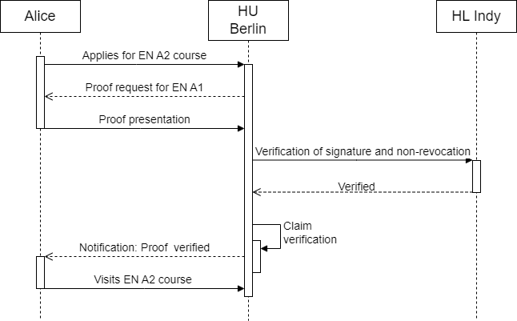
2.2 Verifizierungsprozess
Demo
MOODLE PLUGIN FÜR VC | JONAS KRAUSE | 25. SEPTEMBER 2023
Notes:
Slide with text in one column (usually not a good idea)
Remarks:
Reference lines are like red lines - they must not be crossed (only in some exceptional cases like for pictures with oversize)
Slide is to be built from bottom to top - start with aligning content and pictures at the bottom reference line
Slide title: Helvetica, 45 pt, bold, uppercase (mandatory)
Slide sub-title: Helvetica, 45 pt, uppercase (optional)
normal text in bullet points: Helvetica 30 pts (or larger, but use the same font size on all slides)
titles for bullet points: Helvetica 40 pts (or larger, approx 10pts larger than normal text, but use the same font size on all slides) - titles for bullet points are optional

Slide 7
3.1 Outlook
Verifikationsprozess mittels Website
Testen des Moodle Plugins
Veröffentlichung des Moodle Plugins
MOODLE PLUGIN FÜR VC | JONAS KRAUSE | 25. SEPTEMBER 2023
Notes:
Slide with text in one column (usually not a good idea)
Remarks:
Reference lines are like red lines - they must not be crossed (only in some exceptional cases like for pictures with oversize)
Slide is to be built from bottom to top - start with aligning content and pictures at the bottom reference line
Slide title: Helvetica, 45 pt, bold, uppercase (mandatory)
Slide sub-title: Helvetica, 45 pt, uppercase (optional)
normal text in bullet points: Helvetica 30 pts (or larger, but use the same font size on all slides)
titles for bullet points: Helvetica 40 pts (or larger, approx 10pts larger than normal text, but use the same font size on all slides) - titles for bullet points are optional

Slide 8
3.2 Referenzen
Vidovič, U., Keršič, V., & Turkanović, M. (2022, July). Integrating Web3 Features into Moodle. In International Congress on Blockchain and Applications (pp. 434-443). Cham: Springer International Publishing.
Karataş, E. (2018). Developing Ethereum blockchain-based document verification smart contract for Moodle learning management system. Bilişim Teknolojileri Dergisi, 11(4), 399-406.
Mikroyannidis, A., Third, A., & Domingue, J. (2020). A case study on the decentralisation of lifelong learning using blockchain technology. Journal of Interactive Media in Education, 2020(1), 1-10.
Jirgensons, M., & Kapenieks, J. (2018). Blockchain and the future of digital learning credential assessment and management. Journal of teacher education for sustainability, 20(1), 145-156.
https://moodle.de/
https://moodle.org/
https://www.tu.berlin/zems/studium-lehre
http://dev.greenlight.bcovrin.vonx.io/
https://w3c-ccg.github.io/vc-ed-use-cases/
https://w3c-ccg.github.io/vc-ed-models/
https://www.w3.org/TR/vc-data-model/
MOODLE PLUGIN FÜR VC | JONAS KRAUSE | 25. SEPTEMBER 2023
Notes:
Slide with text in one column (usually not a good idea)
Remarks:
Reference lines are like red lines - they must not be crossed (only in some exceptional cases like for pictures with oversize)
Slide is to be built from bottom to top - start with aligning content and pictures at the bottom reference line
Slide title: Helvetica, 45 pt, bold, uppercase (mandatory)
Slide sub-title: Helvetica, 45 pt, uppercase (optional)
normal text in bullet points: Helvetica 30 pts (or larger, but use the same font size on all slides)
titles for bullet points: Helvetica 40 pts (or larger, approx 10pts larger than normal text, but use the same font size on all slides) - titles for bullet points are optional

